Slide 1
Budget Text Processing
By:
Naseeb
Akash
Sultan
Unnati Khivasara
Miguel Gaspar

Slide 2
Preview
Introduction about the project
Data
Goals
Progress
Questions

Slide 3

Introduction
Budget Text Analysis:
Budget is a word we are familiar with, but what is text analysis?

Slide 4

Introduction
In short, text analysis is the automated process that allows machines to extract and classify information from text.
But why would one want to do that?

Slide 5
Introduction
Businesses might want to extract specific information, like keywords, names, or organization information. They may even want to categorize text with tags according to topic or viewpoint, or classify it as positive or negative.

Slide 6
Data
Source data: The data is obtained from the following organizations:
Guilford County
Wake County
Mecklenburg County
Durham County
City of Charlotte
City of Durham
City of Raleigh

Slide 7
Data
Data Set for the project:
Primarily, 7 pdf files ranging from 400-500 pages long for each.

Slide 8
Goals
Understand/Analyze Budget Text Data
Two primary goals:
Topic Modeling for Budget Texts
Emotion and Sentiment Analysis of Budget Texts
Next work recommender for the texts in Budget (If time permits).

Slide 9
Progress
Teams Structure:
Topic Modeling:
Naseeb
Sultan
Miguel
Emotion and Sentiment Analysis:
Akash
Unatti

Slide 10

Tasks
Data segregation: Akash, Sultan
Data Cleanup: Naseeb, Unnati, Akash, Miguel
Data Organization: Akash, Miguel
Research on finalizing suitable approach /techniques used for analysis: Naseeb, Unnati, Miguel
Preparing Documents: Unnati, Sultan
Preparing Document Term Matrix: Sultan, Naseeb
Analysis : Everyone

Slide 11
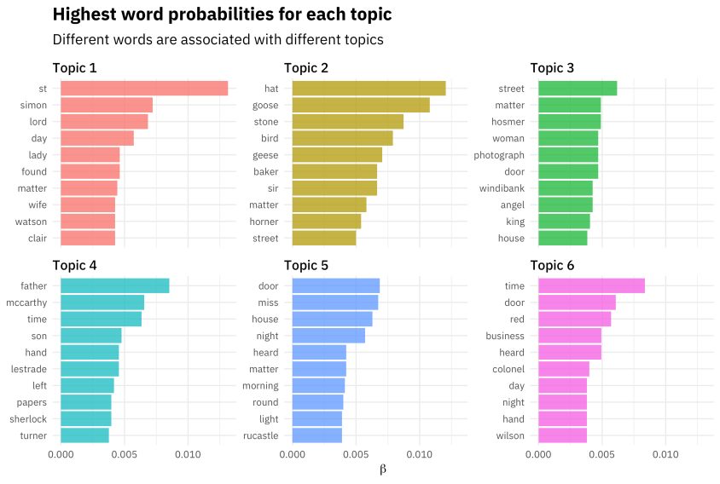
Topic Modeling Topic modeling can be described as a method for finding a group of words (i.e topic) from a collection of documents that best represents the information in the collection. It can also be thought of as a form of text mining – a way to obtain recurring patterns of words in textual material.
Contributors :
Naseeb
Sultan
Miguel

Slide 12
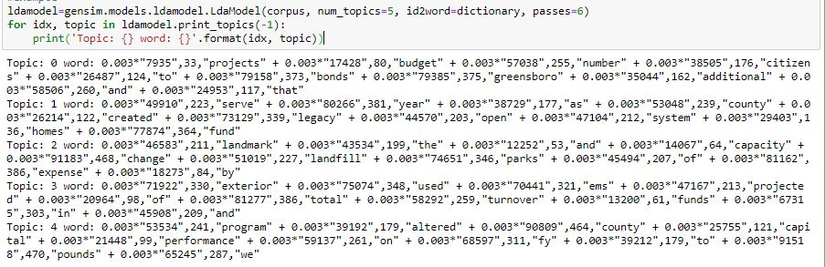
Topic Modeling

Slide 13

Emotion and Sentiment Analysis Sentiment analysis and emotional analysis are two key methods experts use to quantify audiences’ emotional engagement. You can use them in your content strategy to unveil readers’ emotional responses to your content. If you manage to uncover how people feel about your content, you can easily make it perfect.
Contributors:
Akash
Unnati Khivasara

Slide 14
Next Word Recommender(optional)
Whenever a user tries to enter a word/s suggest the next word based on combination of words used as input in previous searches.
Naseeb
Akash
Sultan
Unnati Khivasara
Miguel Gaspar

Slide 15

Questions?

Slide 16


